Slide 1
Match making
Naveen Garg, CSE, IIT Delhi

Slide 2
Lets begin with a card trick!
A magician asks an audience to pick 5 cards from a standard deck offered by his Assistant.
The audience gives the cards to the Assistant.
The Assistant will return one card to the audience.
The Assistant tells the magician what the remaining 4 cards are.
The magician tells you what the fifth card was.

Slide 3
The card trick
Was invented by Fitch Cheney and first appeared in 1950 in the Math miracles.
The trick can be done even with a deck of 124 cards (all distinctly numbered).

Slide 4
A 2-player Path Game
Player 1 and Player 2 alternate picking vertices forming a path. The first to get stuck loses.
Player 1 loses

Slide 5
A 2-player Path Game
Another run.
Player 2 loses
Do either player have a winning strategy?
Does the answer depend on the graph?

Slide 6
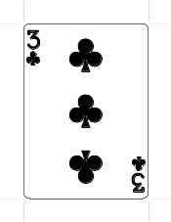
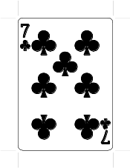
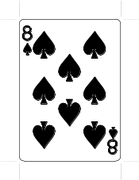
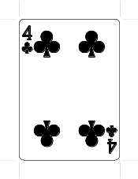
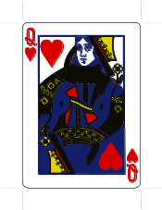
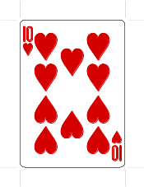
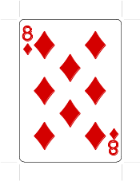
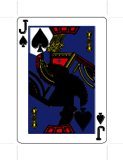
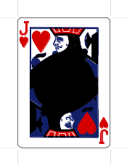
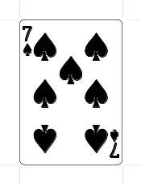
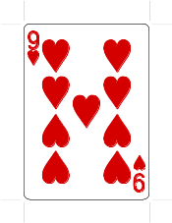
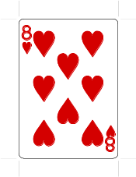
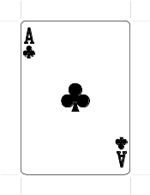
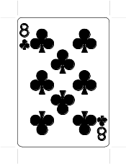
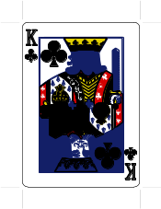
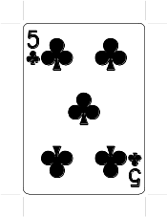
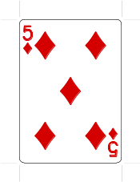
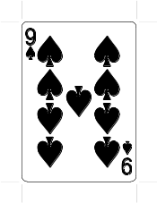
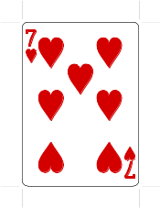
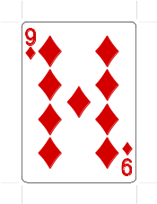
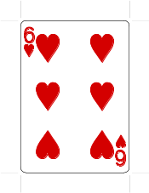
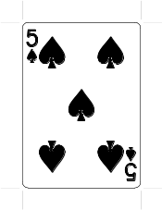
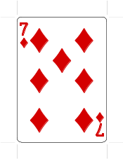
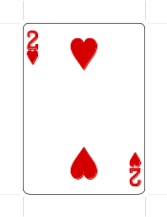
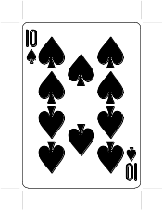
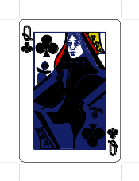
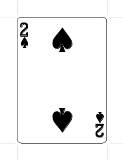
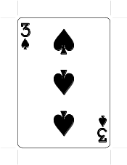
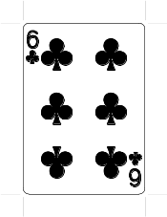
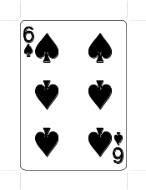
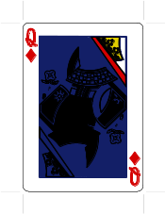
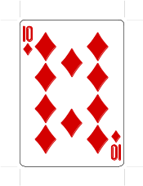
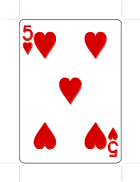
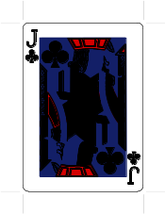
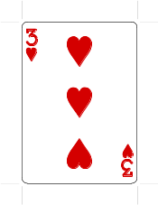
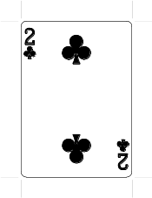
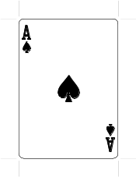
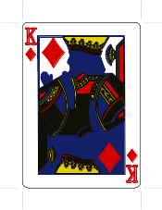
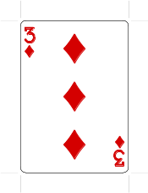
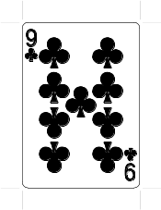
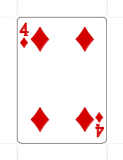
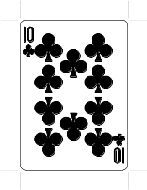
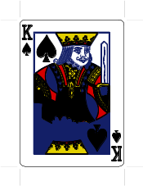
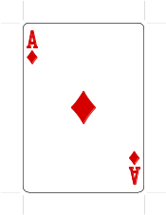
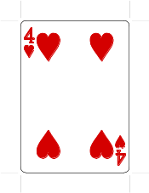
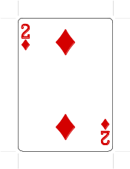
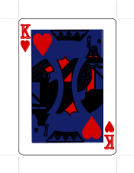
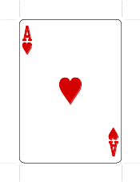
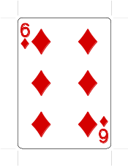
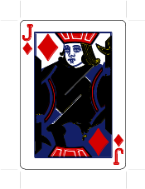


A card puzzle
A deck of playing cards arranged in a 4x13 grid
Pick one card from each column so as to get all values (Ace to King)

Slide 7
A card puzzle
A deck of playing cards arranged in a 4x13 grid
Pick one card from each column so as to get all values (Ace to King)
Is this always possible or does it depend on the arrangement of cards?

Slide 8
Pairing Players
 | W1 | W2 | W3 | W4 | W5
M1 |  | yes | yes
M2 | yes |  | yes
M3 | yes | yes |  | yes
M4 |  | yes |  | yes | yes
M5 |  |  | yes
5 men and 5 women players.
Each player can be paired only with some other players
Can you make 5 teams for a mixed doubles game?
M1
M2
M3
M4
M5
W1
W2
W3
W4
W5
A bipartite graph

Slide 9
Pairing Players
M1
M2
M3
M4
M5
5 men and 5 women players.
Each player can be paired only with some other players
Can you make 5 teams for a mixed doubles game?
W1
W2
W3
W4
W5
Yes
M1-W2, M2-W1, M3-W4, M4-W5, M5-W3
The bipartite graph has a perfect matching

Slide 10

Pairing Players
M1
M2
M3
M4
M5
Suppose M2, W1 had a fight and do not want to be partners anymore.
Is a perfect matching still possible?
No. Because M2, M5 can partner only with W3.
{M2,M5} is a Hall set.
W1
W2
W3
W4
W5
Let N(S) denote the neighbors (possible partners) of a set S.
A Hall set is a set of vertices, S, such that $\left|N\left(S\right)\right|<|S|$

Slide 11

Hall’s theorem
A bipartite graph has a perfect matching iff it has no Hall set.
If for every set of vertices, S, $|N\left(S\right)|≥|S|$, then the bipartite graph has a perfect matching

Slide 12
Solution to the card puzzle
A deck of playing cards arranged in a 4x13 grid
Pick one card from each column so as to get all values (Ace to King)
Is this always possible or does it depend on the arrangement of cards?

Slide 13
Solution to the card puzzle
ACE
No matter how cards are arranged we can always pick one from each column to get all values.
A,Q,9,Q
One side of bipartite graph has a vertex for each column.
The other side has a vertex for each value (ace to king).
13 vertices on each side.
Edge between column, c, and value, v, if v appears in column c.
Each column-vertex has 4 edges incident.
Each value-vertex has 4 edges incident.
2
9
QUEEN
KING

Slide 14

Solution to the card puzzle
ACE
Every vertex of G has degree 4.
Claim: G has no Hall set.
Proof by contradiction:
Let S be a Hall set.
$4|S|$ edges incident to S and hence to N(S)
If $\left|N\left(S\right)\right|<|S|$ then some vertex of N(S) has degree more than 4.
Hence G has a perfect matching.
If perfect matching pairs column 5 to card QUEEN then pick QUEEN from this column.
S
2
N(S)
KING

Slide 15
Stable Marriages
W1 | M2 | M4 | M5 | M1 | M3
W2 | M3 | M1 | M4 | M2 | M5
W3 | M4 | M5 | M2 | M3 | M1
W4 | M5 | M4 | M2 | M1 | M3
W5 | M2 | M3 | M1 | M4 | M5
Each woman has a preference order on the 5 men.
Each man has a preference order on the 5 women.
A matching M is called stable if there is no unstable pair.
A pair (m,w) is unstable if
  (m,w) are not matched to each other in M
  both m and w prefer each other over their partners in the matching M.
M1 | W3 | W4 | W2 | W1 | W5
M2 | W2 | W3 | W1 | W5 | W4
M3 | W2 | W3 | W5 | W4 | W1
M4 | W3 | W2 | W4 | W1 | W5
M5 | W2 | W3 | W4 | W5 | W1

Slide 16
Stable Marriages
W1 | M2 | M4 | M5 | M1 | M3
W2 | M3 | M1 | M4 | M2 | M5
W3 | M4 | M5 | M2 | M3 | M1
W4 | M5 | M4 | M2 | M1 | M3
W5 | M2 | M3 | M1 | M4 | M5
A pair (m,w) is unstable if both m and w prefer each other over their partners in the matching M.
Is this a stable matching?
Is W1-M4 unstable?
NO
Is W2-M3 unstable?
YES! Both prefer each other over current partners.
M1 | W3 | W4 | W2 | W1 | W5
M2 | W2 | W3 | W1 | W5 | W4
M3 | W2 | W3 | W5 | W4 | W1
M4 | W3 | W2 | W4 | W1 | W5
M5 | W2 | W3 | W4 | W5 | W1

Slide 17
Men propose women dispose
W1 | M2 | M4 | M5 | M1 | M3
W2 | M3 | M1 | M4 | M2 | M5
W3 | M4 | M5 | M2 | M3 | M1
W4 | M5 | M4 | M2 | M1 | M3
W5 | M2 | M3 | M1 | M4 | M5
Gale-Shapley algorithm proceeds in rounds. In each round:
Every man who is not matched proposes to his most preferred woman.
Each woman (tentatively) accepts the most preferred man she has received a proposal from and rejects rest.
Rounds continue till there is an unpaired man/woman.
M1 | W3 | W4 | W2 | W1 | W5
M2 | W2 | W3 | W1 | W5 | W4
M3 | W2 | W3 | W5 | W4 | W1
M4 | W3 | W2 | W4 | W1 | W5
M5 | W2 | W3 | W4 | W5 | W1

Slide 18
Men propose women dispose
W1 | M2 | M4 | M5 | M1 | M3
W2 | M3 | M1 | M4 | M2 | M5
W3 | M4 | M5 | M2 | M3 | M1
W4 | M5 | M4 | M2 | M1 | M3
W5 | M2 | M3 | M1 | M4 | M5
Gale-Shapley algorithm proceeds in rounds. In each round:
Every man who is not matched proposes to his most preferred woman.
Each woman (tentatively) accepts the most preferred man she has received a proposal from and rejects rest.
Rounds continue till there is an unpaired man/woman.
M1 | W3 | W4 | W2 | W1 | W5
M2 | W2 | W3 | W1 | W5 | W4
M3 | W2 | W3 | W5 | W4 | W1
M4 | W3 | W2 | W4 | W1 | W5
M5 | W2 | W3 | W4 | W5 | W1

Slide 19
Men propose women dispose
W1 | M2 | M4 | M5 | M1 | M3
W2 | M3 | M1 | M4 | M2 | M5
W3 | M4 | M5 | M2 | M3 | M1
W4 | M5 | M4 | M2 | M1 | M3
W5 | M2 | M3 | M1 | M4 | M5
Gale-Shapley algorithm proceeds in rounds. In each round:
Every man who is not matched proposes to his most preferred woman.
Each woman (tentatively) accepts the most preferred man she has received a proposal from and rejects rest.
Rounds continue till there is an unpaired man/woman.
M1 | W3 | W4 | W2 | W1 | W5
M2 | W2 | W3 | W1 | W5 | W4
M3 | W2 | W3 | W5 | W4 | W1
M4 | W3 | W2 | W4 | W1 | W5
M5 | W2 | W3 | W4 | W5 | W1

Slide 20
Men propose women dispose
W1 | M2 | M4 | M5 | M1 | M3
W2 | M3 | M1 | M4 | M2 | M5
W3 | M4 | M5 | M2 | M3 | M1
W4 | M5 | M4 | M2 | M1 | M3
W5 | M2 | M3 | M1 | M4 | M5
Gale-Shapley algorithm proceeds in rounds. In each round:
Every man who is not matched proposes to his most preferred woman.
Each woman (tentatively) accepts the most preferred man she has received a proposal from and rejects rest.
Rounds continue till there is an unpaired man/woman.
M1 | W3 | W4 | W2 | W1 | W5
M2 | W2 | W3 | W1 | W5 | W4
M3 | W2 | W3 | W5 | W4 | W1
M4 | W3 | W2 | W4 | W1 | W5
M5 | W2 | W3 | W4 | W5 | W1

Slide 21
Is this any use?
The Gale-Shapley algorithm always finds a stable matching.
GS and variants are used for matching interns to hospitals, students to high schools, kidneys to patients…
The Gale-Shapley algorithm was cited by the Nobel Prize committee, awarding the Nobel Economics Prize 2012 to Lloyd Shapley and Alvin Roth.

Slide 22


Slide 23
Google Adwords
Search engines like Google, Bing, Yahoo make the bulk of their revenue by showing ads.
Merchants bid for keywords related to their business.
When you search for the keyword Google shows the ad(s) of the merchants who bid for this keyword.
If a merchant’s ad appears he pays google the bid value.
Each merchant specifies a daily budget and that is the maximum he pays google in a day.

Slide 24

The adwords problem
$n$ bidders with daily budgets $B_{1},B_{2},…B_{n}$.
Queries (keyword searches) arrive online.
Bidder $i$ is willing to pay $u_{ij}$ rupees if his ad is shown for query $j$.
Algorithm has to show the ad of one of the bidders without knowing future queries.
Total revenue collected from bidder $i$ cannot exceed $B_{i}$.
Algorithm has to collect the maximum revenue

Slide 25
Adwords and online mathing
Consider a bipartite graph with the bidders on one side and the queries on the other.
When a query arrives it has to be matched to one of the bidders.
The number of queries a bidder can be matched to is governed by his daily budget.

Slide 26

Matching in non-bipartite graphs
Graph $G=\left(V,E\right), V$ is set of nodes and $E⊆V×V$ is set of edges.
A matching $M$ is a subset of edges so that no two edges of $M$ have a common end-point
Red edges form a matching
Blue edges do not form a matching

Slide 27
Winning strategy for the path game
A matching is perfect if all vertices are matched.
If G has a perfect matching Player 2 has a winning strategy.
Whatever Player 1 picks, Player 2 picks its matched partner.

Slide 28
Winning strategy for the path game
If G does not have a perfect matching Player 1 has a winning strategy.
Player 1 picks a maximum matching.
It starts from an unmatched vertex.
Now Player 2 has to pick a matched vertex and Player 1 can pick its partner in the matching.

Slide 29
Finally, the secret of the card trick
Amongst the 5 cards you chose, two have to be of the same suit, say club.
If the two clubs were 5C and 10C, then the assistant returns 10C to the audience.
The first card the assistant shows me is 5C. So that I know the suit of the hidden card.
There are 6 permutations of the remaining 3 cards. Using these the assistant generates a number from 1 to 6 which I then add to 5 to get the value of the hidden card.

Slide 30

What does this have to do with matchings?
The assistant can convey $5×4!=120$ pieces of information.
Information theory says that it may be possible to work with a deck of 124 cards.
This upperbound can be achieved using matchings.

Slide 31
Using matchings to get to the upperbound
Make a bipartite graph where vertices on left are all subsets of 5 cards.
Vertices on right are all possible 4 card sequences.
There is an edge between two vertices if the 4 cards on the right are a subset of the 5 cards on the left.
Note each vertex has degree 120 and so graph has a perfect matching.
This matching tells the assistant what sequence to give when presented with a certain set of 5 cards. Ditto for magician.

Slide 32
Thank You

