Slide 1
What is “Hard” about NP-Hard
Naveen Garg

Slide 2
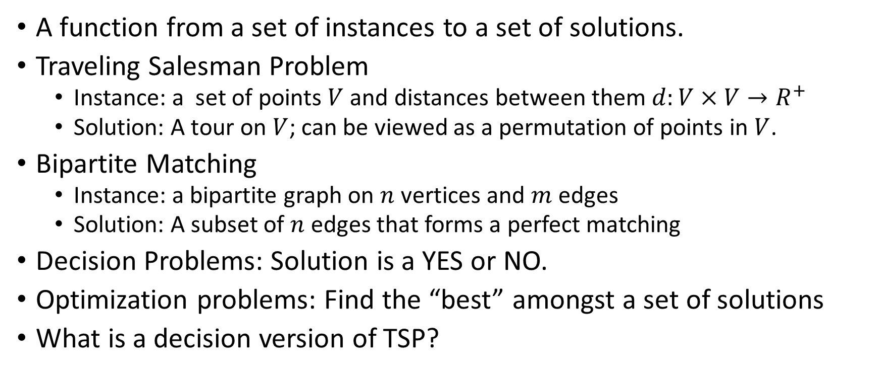
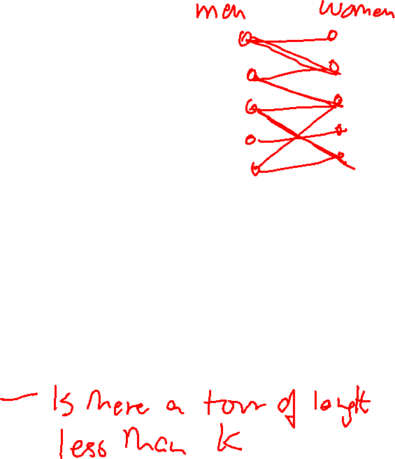
What is a problem?
A function from a set of instances to a set of solutions.
Traveling Salesman Problem
  Instance: a set of points $V$ and distances between them $d:V×V→R^{+}$
  Solution: A tour on $V$; can be viewed as a permutation of points in $V$.
Bipartite Matching
  Instance: a bipartite graph on $n$ vertices and $m$ edges
  Solution: A subset of $n$ edges that forms a perfect matching
Decision Problems: Solution is a YES or NO.
Optimization problems: Find the “best” amongst a set of solutions
What is a decision version of TSP?

Slide 3
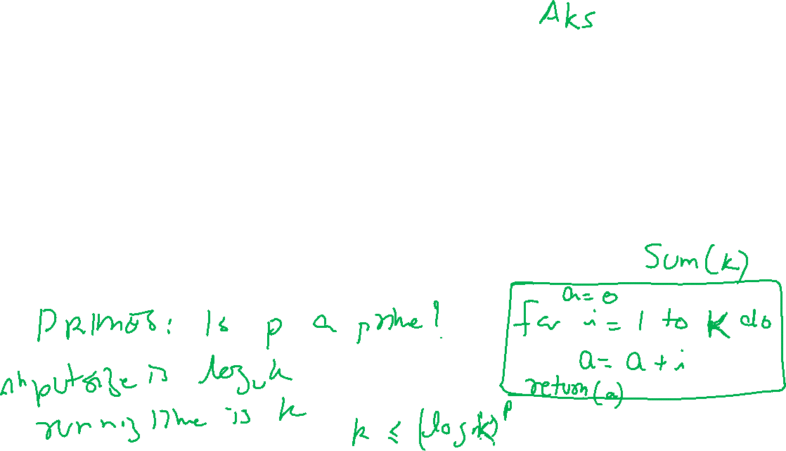
When is a problem easy?
When we have an “efficient” algorithm for solving it.
An algorithm is efficient if it runs in “polynomial time”.
Polynomial time: Running time of algorithm is bounded by a polynomial in the “size of instance”.
Size of instance is number of bits required to encode it.

Slide 4
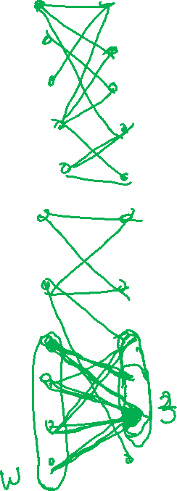
Another definition of “easy”
A (decision) problem is “easy” when it has “short”, YES and NO certificates.
Short: Bounded by a polynomial in the size of the instance
YES certificate: A prover can use the certificate to verify that the answer to the instance is YES
NO certificate: A prover can use the certificate to verify that the answer to the instance is NO
What are YES and NO certificates for Bipartite matching?

Slide 5
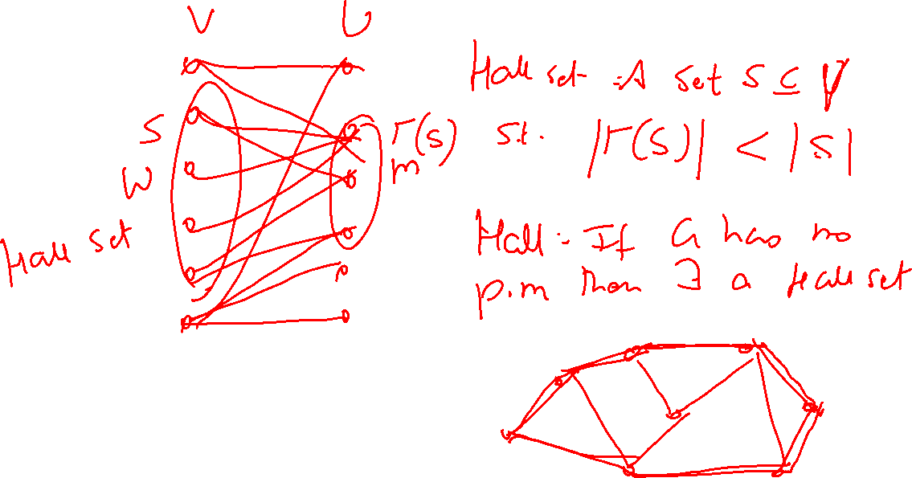

Slide 6
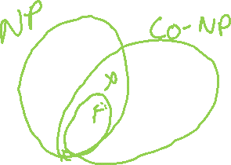
So when is a problem “not easy”
When it does not have a polynomial time algorithm.
When it does not have both YES and NO certificates.
  Problem has a YES certificate: NP (for not deterministic polynomial)
  Problem has a NO certificate: co-NP (for complement of NP)
Examples of NP and co-NP problems.
How does one argue that no polynomial time algorithm is possible?

Slide 7
Polynomial reductions
A polynomial reduction from problem A to problem B, establishes that a polynomial time algorithm for B yields a polynomial time algorithm for A.
Polynomial time algorithm for A
YES
Converts Instance of A to Instance of B
Polynomial time Algorithm for B
YES
Instance of A
Instance of B
NO
NO

Slide 8
So what is “hard”
We do not show that a problem cannot be solved in polynomial time.
We only show that if it can then some other problem too can be solved in polynomial time.
Thus we have a large collection of “equivalent” problems; if one falls the other dominoes will too.
Cook and Levin showed that if CIRCUIT SAT has a p-time algorithm then all problem in NP can be solved in p-time.
CIRCUIT-SAT was the first NP-hard problem; “harder” than any problem in NP.

Slide 9
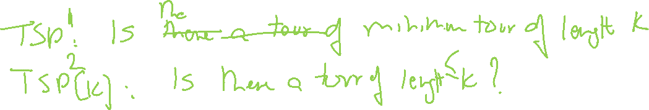
NP-hard
Through polynomial time reductions a huge number of problems have been shown to be NP-hard.
Not all NP-hard problems are in NP. Example?
If a problem is NP-hard and in NP then it is one of the hardest problems in NP. These are NP-complete problems.

