Slide 1
Learning with Experts
Amit Kumar (IIT Delhi)

Slide 2








Multiple experts
Multiple experts with conflicting recommendations…
whom to trust ??

Slide 3






Multiple experts
You want to invest money in stocks….which stocks to buy ??

Slide 4
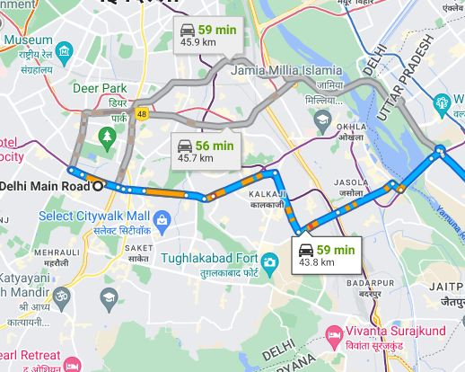
Multiple experts
You commute from home to college everyday, which route to take ??

Slide 5







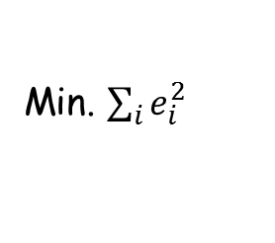
Linear Regression
Given a set of points, find the best-fit line.
$$e_{7}$$
$$e_{6}$$
$$e_{4}$$
$$e_{3}$$
$$e_{5}$$
Min. ${\sum_{i}{e_{i}^{2}} }_{ }$
$$e_{1}$$
$$e_{2}$$
Can be used to predict the y-coordinate of the next data-point

Slide 6
Linear Regression…online learning
Points arrive over time….when a new point arrives, we can change the current
line to get better error next time….
$$e_{7}$$
$$e_{6}$$
$$e_{4}$$
$$e_{3}$$
$$e_{5}$$
What are the experts ??
$$e_{1}$$
$$e_{2}$$

Slide 7
Linear Classification
Given a set of red and blue points, find a line separating them..
min. number of mis-classified points.
Can be used to predict the colour of the next data-point

Slide 8
Linear Classification
Points arrive over time….when a new point arrive, can change the current line
to get better prediction for the next point.
What are the experts ??

Slide 9
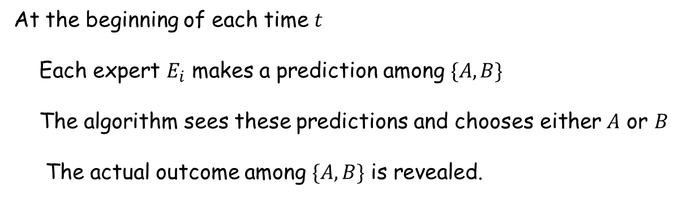

Abstract Problem
Given $N$ experts, $E_{1}, E_{2}, …, E_{N}$
At the beginning of each time $t$
Each expert $E_{i}$ makes a prediction among $\{A,B\}$
The algorithm sees these predictions and chooses either $A$ or $B$
The actual outcome among $\{A,B\}$ is revealed.
Goal: Minimize the number of mistakes…
(compared to the best expert)

Slide 10
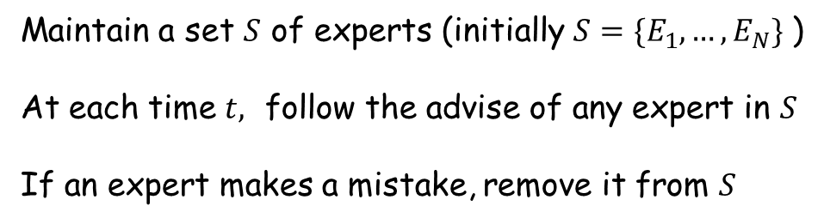
Abstract Problem
Given $N$ experts, $E_{1}, E_{2}, …, E_{N}$
At the beginning of each time $t$
Each expert $E_{i}$ makes a prediction among $\{A,B\}$
The algorithm sees these predictions and chooses either $A$ or $B$
The actual outcome among $\{A,B\}$ is revealed.
Attempt at an algorithm:
Maintain a set $S$ of experts (initially $S=\{E_{1}, …, E_{N}\}$ )
At each time $t,$ follow the advise of any expert in $S$
If an expert makes a mistake, remove it from $S$

Slide 11
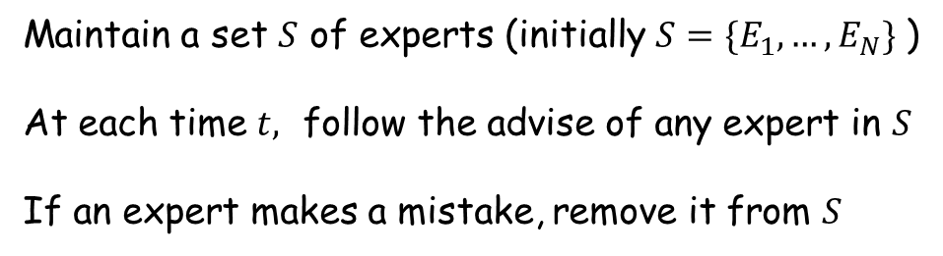
Learning from experts
Attempt at an algorithm:
Maintain a set $S$ of experts (initially $S=\{E_{1}, …, E_{N}\}$ )
At each time $t,$ follow the advise of any expert in $S$
If an expert makes a mistake, remove it from $S$
Assume that there is an expert which never makes a mistake….
how many mistakes will this algorithm make ??
Is there a better algorithm ??

Slide 12
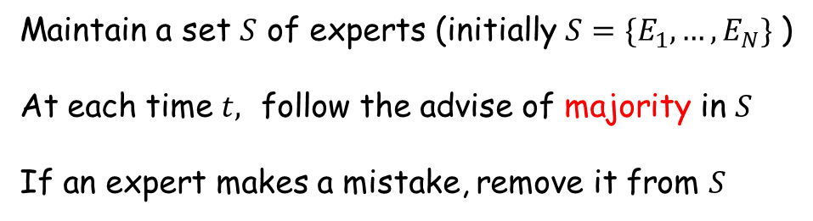
Majority Voting
Maintain a set $S$ of experts (initially $S=\{E_{1}, …, E_{N}\}$ )
At each time $t,$ follow the advise of majority in $S$
If an expert makes a mistake, remove it from $S$
Assume that there is an expert which never makes a mistake….
how many mistakes will this algorithm make ??
What are the issues with this algorithm??

Slide 13
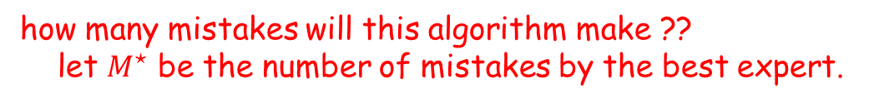
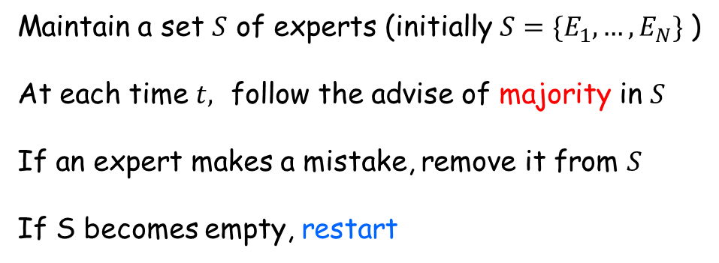
Majority Voting
Maintain a set $S$ of experts (initially $S=\{E_{1}, …, E_{N}\}$ )
At each time $t,$ follow the advise of majority in $S$
If an expert makes a mistake, remove it from $S$
If S becomes empty, restart
how many mistakes will this algorithm make ??
let $M^{⋆}$ be the number of mistakes by the best expert.
#mistakes by the algorithm $≤{\log_{2}N⋅(M}^{⋆}+1)$
Can we improve this bound ??

Slide 14
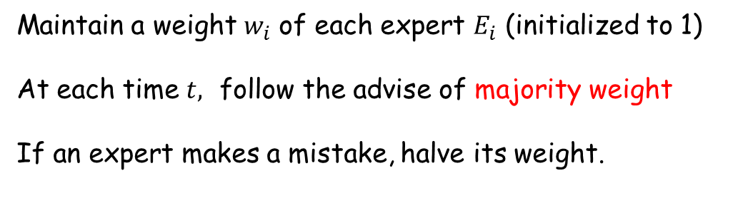

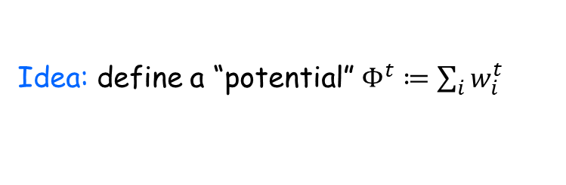
Halving Algorithm
Maintain a weight $w_{i}$ of each expert $E_{i}$ (initialized to 1)
At each time $t,$ follow the advise of majority weight
If an expert makes a mistake, halve its weight.
let $M^{⋆}$ be the number of mistakes by the best expert.
Thm: #mistakes by the algorithm $≤c⋅M^{⋆}+O(\log{N)}$
Weight of expert $E_{i}$ at time $t$
Idea: define a “potential” $Φ^{t}≔\sum_{i}{w_{i}^{t}}$

Slide 15
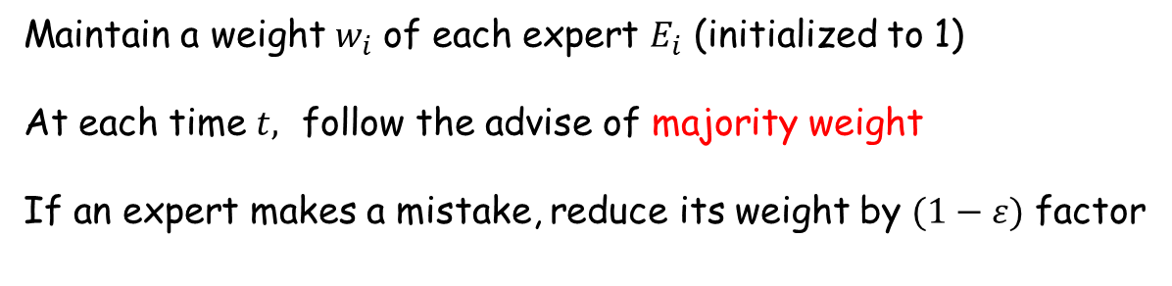
Halving Algorithm
Thm: #mistakes by the algorithm $≤c⋅M^{⋆}+O(\log{N)}$
How small can this constant become ?
Maintain a weight $w_{i}$ of each expert $E_{i}$ (initialized to 1)
At each time $t,$ follow the advise of majority weight
If an expert makes a mistake, reduce its weight by $(1−ε)$ factor
Thm: #mistakes by the algorithm $≤(2+ε)⋅M^{⋆}+O(\frac{\log{N}}{ε})$
Can we improve this further ?

Slide 16
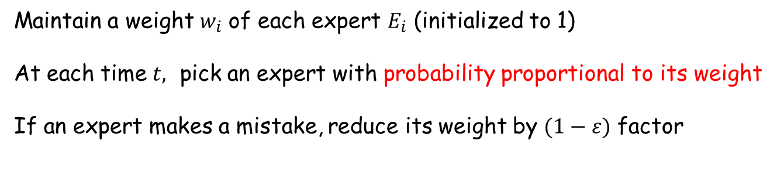
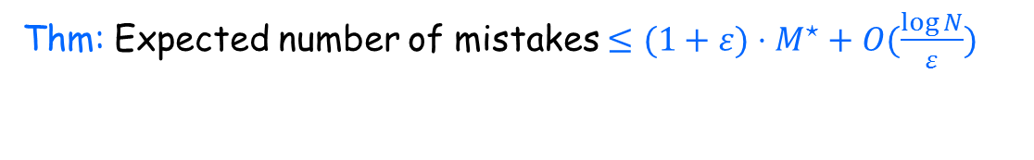
Another Idea…
Thm: There cannot be a deterministic algorithm with number of mistakes
less than $2⋅M^{⋆}$
How to do better ?? (recall the stocks example…)
Use “mixture” of experts ??
Maintain a weight $w_{i}$ of each expert $E_{i}$ (initialized to 1)
At each time $t,$ pick an expert with probability proportional to its weight
If an expert makes a mistake, reduce its weight by $(1−ε)$ factor
Thm: Expected number of mistakes $≤(1+ε)⋅M^{⋆}+O(\frac{\log{N}}{ε})$

Slide 17
Other issues…
Regret bounds…
What if the problem requires more than binary decision making ??
What happens when there are infinite number of experts ??

